Slide 1

CSE7101- Capstone Project
Review-1
PSCS_35: 360-Degree Feedback Software for News Stories in Regional Media (using AI/ML)
Batch Number: CSE_150
Under the Supervision of,
Dr.Aarif Ahamed S
School of Computer Science and Engineering
Presidency University
Roll Number | Student Name
YASHAS RAJ S | 20231CSE3019
RAKSHITHA REDDY KS | 20231CSE3089
SACHIN KUMAR SAROJ | 20231CSE3018
Name of the Program: NewslensAI
Name of the HoD: Dr. Asif Mohammad
Name of the Program Project Coordinator: Dr.Aarif Ahamed S
Name of the School Project Coordinators: Dr. Sampath A K , Dr. Geetha A

Slide 2
Problem Statement Number:
Problem Description:
PSCS_35: 360-Degree Feedback Software for News Stories in Regional Media (using AI/ML)
Our project is designed with clear, measurable objectives to ensure we deliver a tangible and impactful solution.
1
2
Primary Objective
Secondary Objectives
Reduce manual effort, human bias, and delays in sentiment and departmental relevance analysis.
To develop an AI/ML-driven system that automatically analyzes sentiment and classifies news stories by relevant government departments or public services in regional media, enabling timely, objective, and scalable insights.
Provide real-time, holistic, and accurate insights to improve media content adaptation and governmental communication.
Enhance public trust and alignment between media reporting and community needs through data-driven decision-making.

Slide 3
Content
Problem Statement
Objectives
Background and Related work for title Selection
Analysis of Problem Statement
Git-hub Link
Timeline of the Project
References

Slide 4
Background and Related work for title Selection
Background
Regional media shapes local opinion but faces challenges in timely sentiment and relevance analysis.
Manual methods are slow, biased, and not scalable.
Related Work
Existing tools focus on social media or national news, not regional context.
Few combine sentiment analysis with departmental classification.
Rationale
Addresses a clear gap with an AI/ML-powered, real-time solution for regional news streams.

Slide 5
Analysis of Problem Statement
Technology Stack Components
Frontend: HTML, CSS, JavaScript (React/Angular for interactive UI)
Backend: Python (Flask) for API and processing
AI/ML & NLP: Python libraries (NLTK, spaCy, scikit-learn, TensorFlow/PyTorch) for sentiment analysis & classification
Database: Python’s built-in data storage SQLite for storing processed news data
Data Sources: Regional news feeds, APIs, RSS
Deployment: replit/varsal for scalability
Version Control: GitHub for collaborative development

Slide 6
Analysis of Problem Statement (contd...)
Current Challenges
Content:
High Volume & Velocity: Regional news streams generate massive amounts of data daily.
Manual Processing: Slow, labor-intensive, and prone to human error/bias.
Delayed Insights: Prevents timely response to public concerns.
Lack of Integration: No unified system for sentiment + departmental relevance analysis.
Purpose: Show the pain points and why the problem is significant.

Slide 7
Analysis of Problem Statement (contd...)
Need for AI/ML Solution
Content:
Automation: Real-time sentiment detection and department tagging.
Scalability: Handles diverse, high-speed regional news data.
Accuracy: Reduces human bias through data-driven analysis.
Decision Support: Enables targeted communication for media and government.
Public Trust: Improves alignment between media coverage and community needs.

Slide 8
Github Link
Github Link
https://github.com/YashasRaj20231CSE3019/capstone-project-CSE_150.git

Slide 9
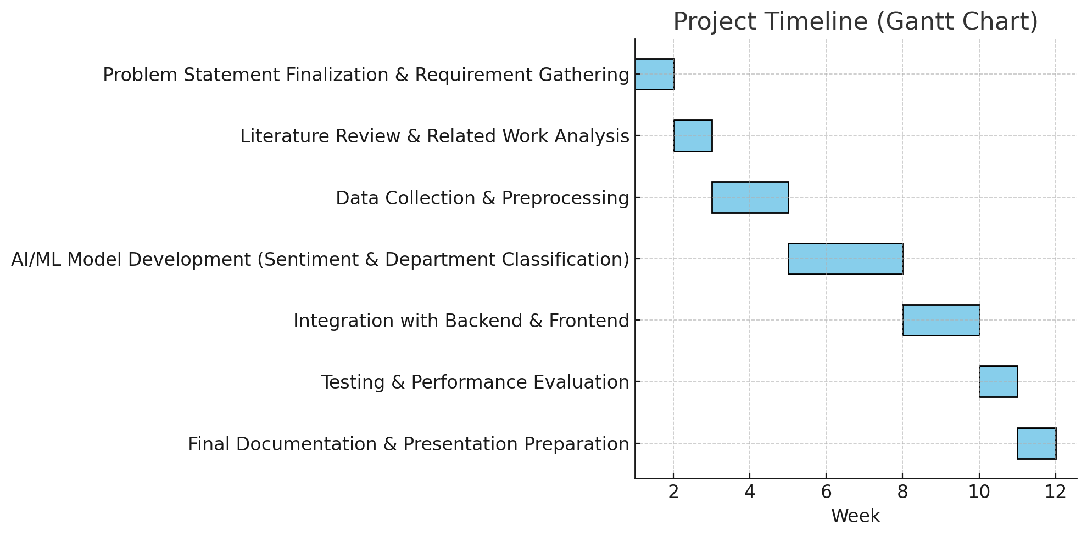
Timeline of the Project (Gantt Chart)

Slide 10
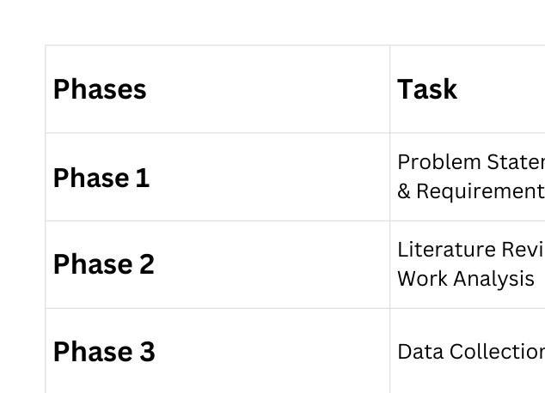
Timeline of the Project (Gantt Chart)

Slide 11
References (IEEE Paper format)
All sources referenced in this presentation adhere strictly to the IEEE citation style.
F. Hamborg, K. Donnay, and B. Gipp, “Towards target-dependent sentiment classification in news articles,” arXiv preprint arXiv:2105.09660, May 2021.
S. Minaee, N. Kalchbrenner, E. Cambria, N. Nikzad, M. Chenaghlu, and J. Gao, “Deep learning based text classification: A comprehensive review,” arXiv preprint arXiv:2004.03705, Apr. 2020.
A. Sinha, S. Kedas, R. Kumar, and P. Malo, “SEntFiN 1.0: Entity-aware sentiment analysis for financial news,” arXiv preprint arXiv:2305.12257, May 2023.
Z. A. Faridzi, D. Pramesti, and R. Y. Fa’rifah, “A comparison of oversampling and undersampling methods in sentiment analysis regarding Indonesia fuel price increase using support vector machine,” in Proc. 2023 Int. Conf. Advancement in Data Science, E-learning and Information System (ICADEIS), Bali, Indonesia, Aug. 2023, pp. 1–6. doi:10.1109/ICADEIS58666.2023.10270851.
A. Alamoodi, et al., “Sentiment analysis of public services for smart society: Literature review and future research directions,” Expert Systems with Applications, 2022.

Slide 12


